Slide 1
NAO Sprint 3 Review
C1C Christian Arnold
C1C Casey Born
C1C Adrian Chiriac
C1C Katrina Domeyer
C1C Colin Schnoes
C1C Jacob Taylor

Slide 2
Sprint 2 Retrospective Meeting
Excel system for better hour tracking
Improvement needed on task assignment
Bad communication between people
Improved SCRUM methodology but SCRUM master needs more support
Improved familiarity with Nao System and capabilities
Robots are fragile and behave unexpectedly
Combined demo avoids technical difficulties
Need to bite as much as we can chew

Slide 3
Sprint 2 Retrospective Meeting (Cont.)
Need to bite as much as we can chew
Administrative time needs to be accounted
Formal design was not implemented
Design and testing time needs to be allocated
Work needed on time estimating
Count only on class time for work time
Not accomplished all PBIs
We got new Star Wars toys
Semi-functional robots with some awesome behaviors
Fast animation development

Slide 4
Sprint 3 Backlog Items
As a K-5 Educator, I need the NAO to play fun games with my students where they practice determining which of two numbers is larger so that they will be motivated to develop and practice their number understanding of numeric ordering.
As a STEM Supporter, I need the NAO to play the High-Low game with students in an age-appropriate conversational manner (K-5, 6-8, 9-12) to help develop number understanding and algorithmic reasoning skills (bisection searching) so that the students are motivated for further studies of computer science.
As a K-5 STEM Supporter, I need the NAO to engage with my students in activities and demos that would encourage their interests in STEM studies and careers so that they will be excited, motivated, and not intimidated to further their studies in STEM subjects to include computer science and robotics.

Slide 5
Sprint 3 Backlog Items (Cont.)
As a Developer for the NAO, I need the NAO to perform animated emotional responses (with or without speaking) to indicate surprise, thinking/pondering, happy, sad, excited, 'whatever' attitude, 'What'z up?', and other similar emotions.
As a Special Needs K-5 Educator, I need the NAO to say (in an animated manner), "Uh, I am upset right now. May I have a break, please" so that the student will understand that it is okay to feel upset and ask for a break.
As a STEM Outreach Educator, I need the NAO to have a repository of Choregraphe modules that can be used by K-5 students to program the NAOs to tell stories of their creation so that I can teach the students some basic programming skills to include sequential, conditional, and iterative logic, concurrency and synchronization, and data storage and retrieval.

Slide 6
Sprint 3 Tasks
BB-8 drive (30 hours)
Move forward
Move backwards
Stop
Others
Design, admin, testing and tracking
Emotions (30 hours)
Tired
Break
Question
Frustrated
Tantrum
Mountain Lions, Paws, Paws
Others
Design, admin, testing and tracking

Slide 7
Sprint 3 Tasks (Cont.)
High Low Game (15 hours)
Middle School & K-5
High School
Cadet
Officer
Design, admin, testing and tracking
Sprint Review Prep (5 hours)
Demo
(Presentation
Admin Framework

Slide 8
Design Model
System architecture
Choregraphe
Nao Robot

Slide 9
Risks
Risks | Likelihood | Impact | Mitigation
Robot Health | High | No testing platform | Continue to send in robots for repairs
Old Source Code | Moderate | “Re-inventing the Wheel” | Contacting old capstone groups, use public repository
Compacted Schedule | Moderate | Low work-efficiency | Better time management, Personal Hour Tracker

Slide 10
Test Plan
Testing is performed incrementally anytime code is physically run on the robot
Verifying animations and flow of program
Finding random people to test robot functionality (Beta testing)

Slide 11
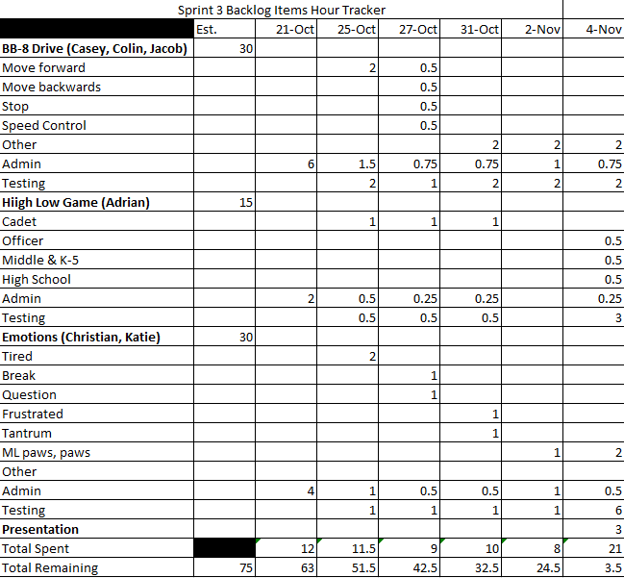
Hour Tracking

Slide 12
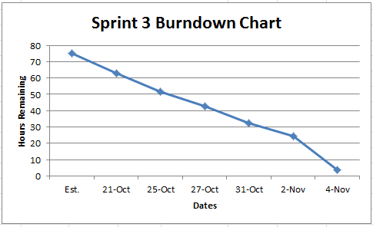
Sprint Burndown Chart

Slide 13
Demo

Slide 14
Anticipated Goals for Next Sprint
Continue Exploring Capabilities and Limitations
K-5 Emotions Demo on Thursday
New Star Wars animations
Voice control over Nao controlling BB-8
…and whatever the client has in mind….

Slide 15
Summary and Takeaways
We accomplished all objectives and more faster than expected
Estimated times were more realistic
Robots are fragile and behave unexpectedly
Robots collapse or go limp
Logic doesn’t work as expected
Sprint schedule overlapped with academic events
Improved Communication

Slide 16
Documentation
University of Notre Dame F.U.N. Lab

Slide 17
Questions?

